Slide 1
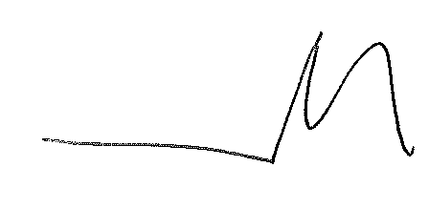
2022/2023 Gender Pay Gap Statement
Diverse Abilities are proud to be an employer who attracts a diverse workforce and employs people from a variety of different ages, backgrounds and nationalities.
We ensure equality in all of our policies and are committed to making sure that our staff receive the same pay for the same role regardless of gender. Equal opportunities are given for management development opportunities across all employees.
Due to the nature of our work, and the Health and Social care sector in general, we have a predominantly female population.
This female to male ratio is increased further as some of our roles can only be filled by females due to ‘genuine occupational reasons’ due to the choices of the people we support.
Due to the nature of our positions, we are able to offer flexible working with various different shift patterns across the majority of our services. This tends to fit well around other responsibilities, such as childcare. This flexibility is reflected by the higher percentage of women we see in roles across our organisation.
The data we have been requested to report is from April 2022
Mark Powell
CEO

Slide 2
2022/2023 Gender Pay Gap Statement
Total Employees
= 383
Total Female
= 328
Total Male
= 55
Average Gender pay gap as a mean average
Men Women
Lower Quartile £8.66 £8.93
Lower Middle Quartile £9.93 £10.03
Upper Middle Quartile £10.36 £10.84
Upper Quartile £21.47 £16.43
A large proportion of male employees work in the lower quartile in our Short Breaks Crew and paid the national minimum wage dependent on their age.
Included in the data are bonuses awarded from Work and retention grants received from the local governing body where we have chosen awarded as one of payments to encourage the retention of staff. Along with staff making commendations to friends and family and receiving a referrals bonus.

Slide 3
2022 Gender Pay Gap Statement
The below chart illustrates the gender distribution across Diverse Abilities workforce in four equally sized quartiles.
Women Men
Lower Quartile 80% 20%
Lower Middle Quartile 23% 77%
Upper Middle 88% 12%
Top Quartile 93% 7%

